Slide 1
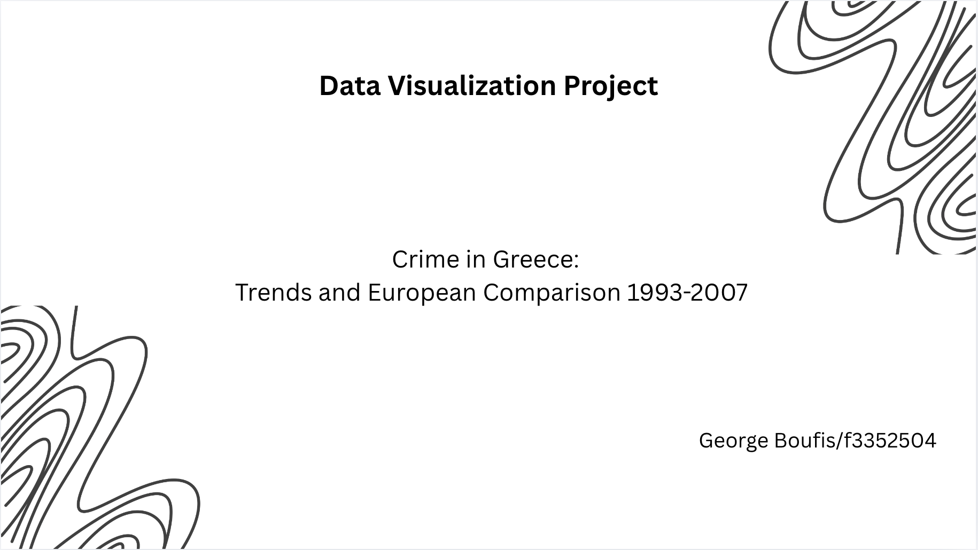

Slide 2
INTRODUCTION
This project examines whether recorded crime rates in Greece increased or decreased between 1993 and 2007.
Greece’s pattern is compared with the rest of Europe using crime rates per 100,000 inhabitants.
The crime data was downloaded from Eurostat, and the interactive visualizations were created using Tableau.

Slide 3
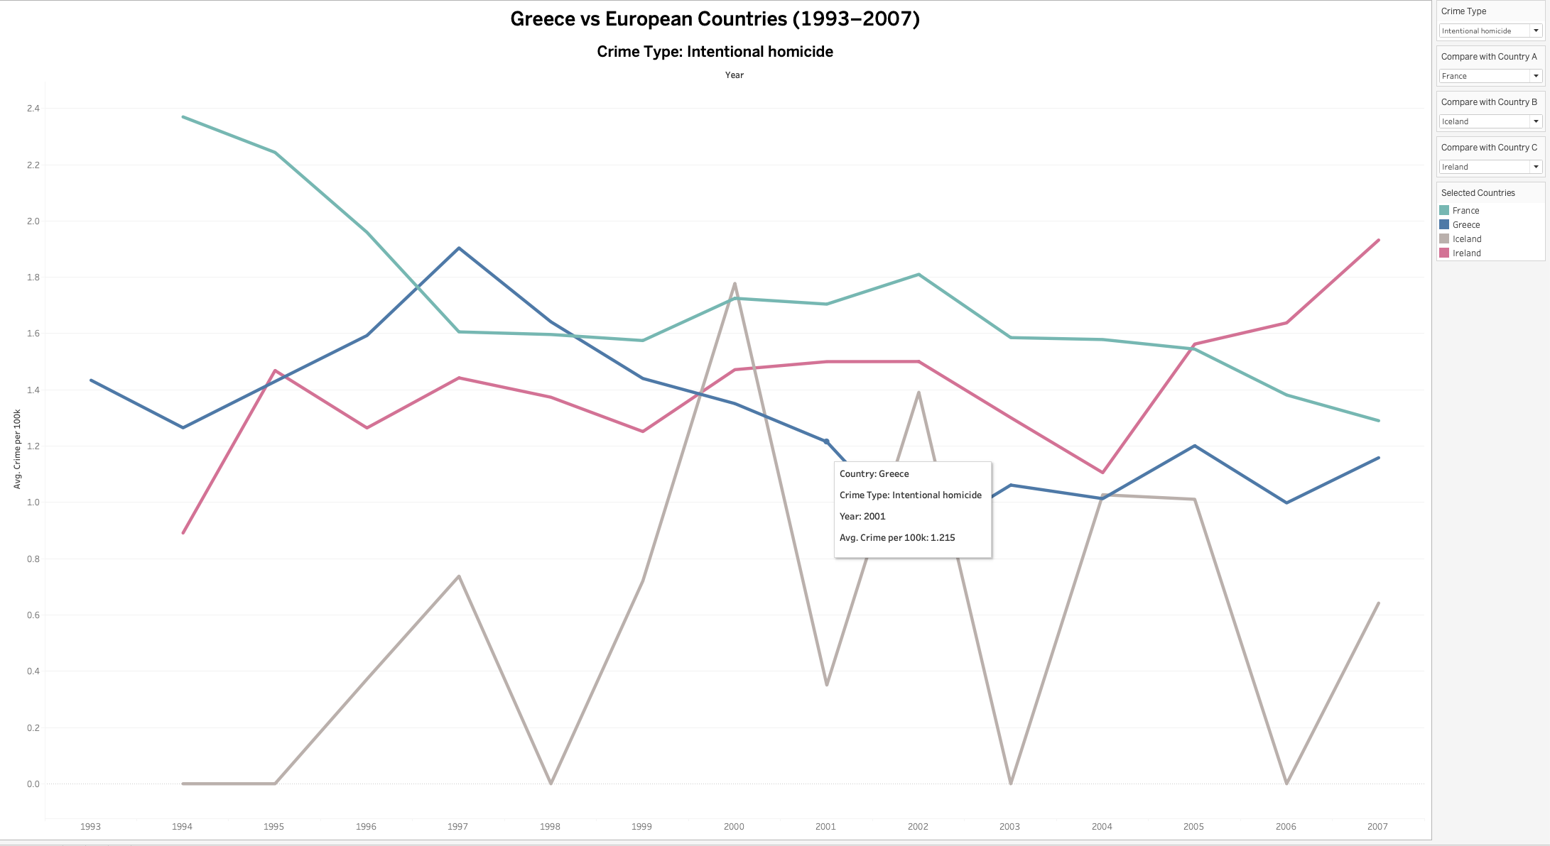
Comparison of Greece with Selected European Countries
Greece is always included as the reference country.
The user can select the crime type from a dropdown menu.
The user can choose up to three additional countries for comparison.
This avoids a spaghetti plot and keeps the visualization readable.
The title updates dynamically based on the selected crime type.
Hovering over a line shows the country, crime-type, year, and average crime rate per 100k population.

Slide 4
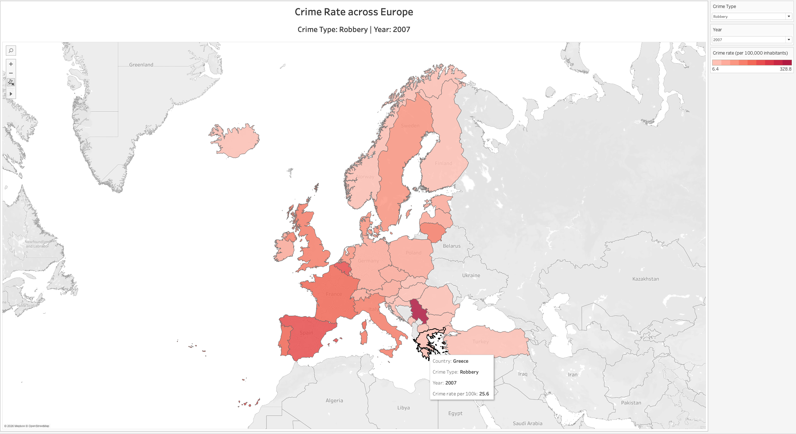
Exploring Spatial Variation in European Crime Rates
The user can select the crime type and year from dropdown menus.
The map updates dynamically based on the selected filters.
The title changes according to the selected crime type and year.
Darker red indicates a higher crime rate per 100k population.
Hovering over a country shows the country name, crime-type, year, and exact crime rate per 100k population.

Slide 5
Interactive Capabilities Offered
Dynamic filtering by crime type, year, and country.
Direct comparison between Greece and selected European countries.
Clear temporal comparison without overcrowding the chart.
Spatial exploration of crime rates across Europe.
Tooltips provide exact values without making the charts visually overloaded.
Main Conclusions:
The interactive features make the analysis more flexible by allowing users to compare Greece with selected countries, explore spatial crime patterns, and inspect exact crime rates per 100k population through dynamic filters and tooltips.

Slide 6


